Slide 1


AR Quick start tutorial
How to get started with Augmented Reality with Unity + Vuforia No programming skills required!
by Chia Tze Hank
About this tutorial
For students attending the AR Workshop, please follow through this PowerPoint to install the required software as it can take hours to work!

Slide 2

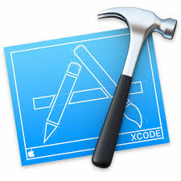


We will be using these software for the workshop
Unity + Vuforia
Android Studio or XCode
Will not be using these software developing, android phone users need to download Android Studio while iPhone Users will use XCode. NOT BOTH.
Unity with Vuforia built-in.
Your IDE for your AR development platform.
Your app building will rely on these software.

Slide 3
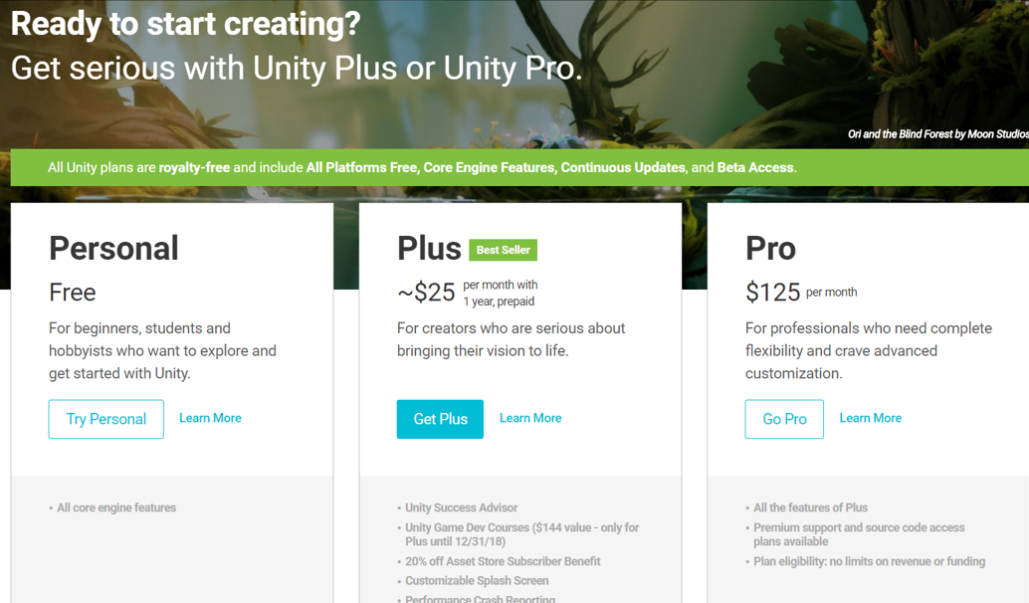
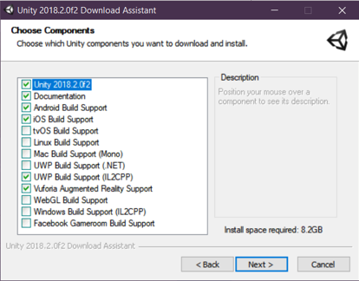
Vuforia Account Setup and Testing
1
Go to https://store.unity.com/ and download the personal package you find on the link above.
2
Run the .exe file, click Next twice, and you should arrive at this page and select all the boxes below.
Once you’re done, click Next until the program starts to download and install the package. (It should take a while, so proceed to next slide. Approx. 2 hours max.

Slide 4
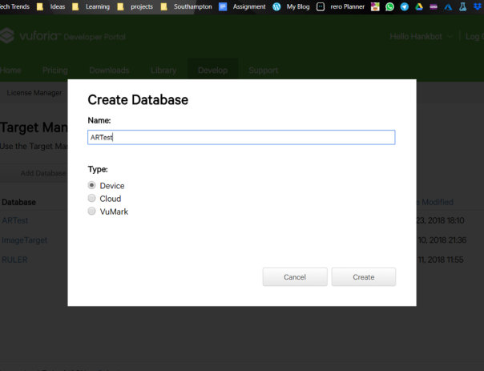
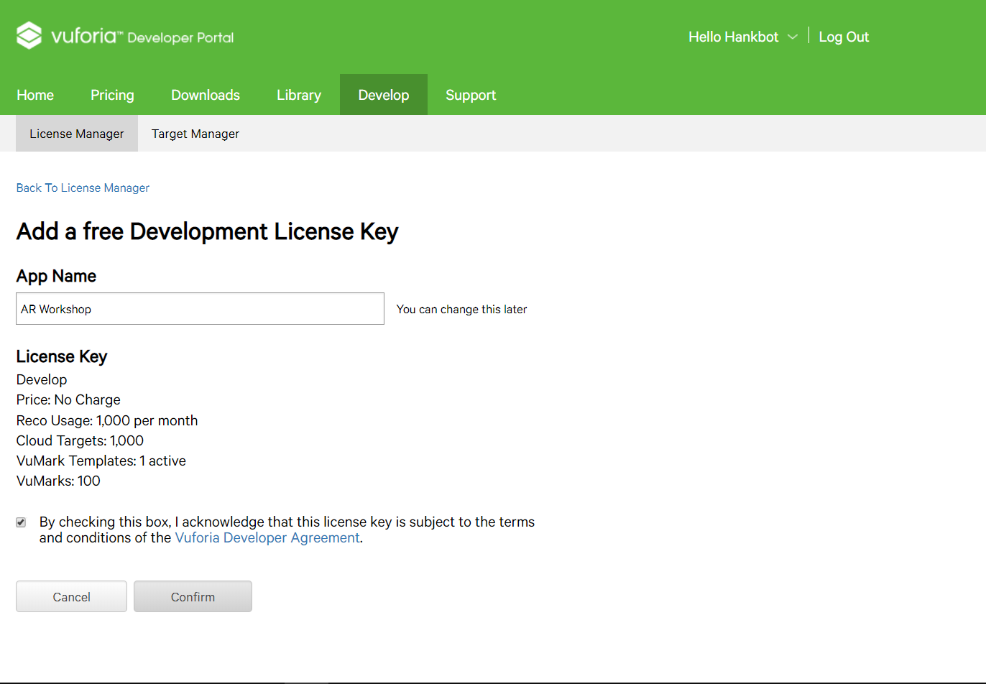
Vuforia Account Setup and Testing
Head on to Vuforia License Manager, create an account with Gmail and go to License Manager, get development key (it’s a free API key which allows you to track images).
Now we got our API key, create a Database at Target Manager. Click add Database. You can name it whatever you want.
3
4

Slide 5
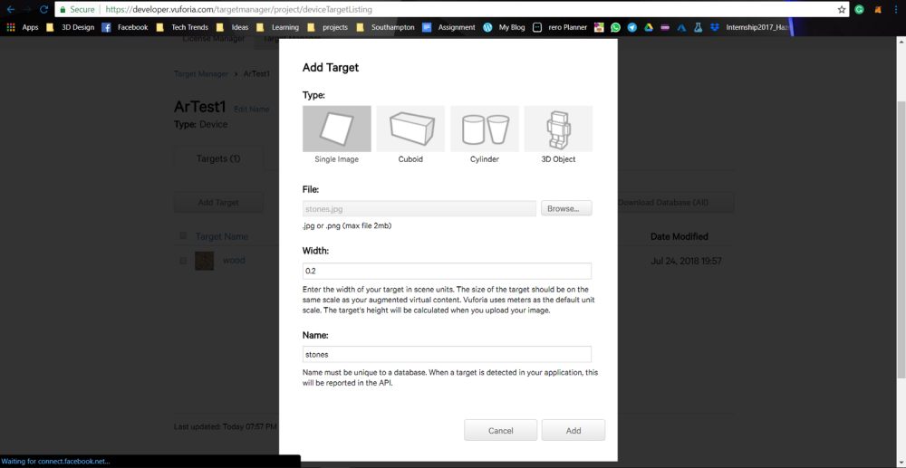
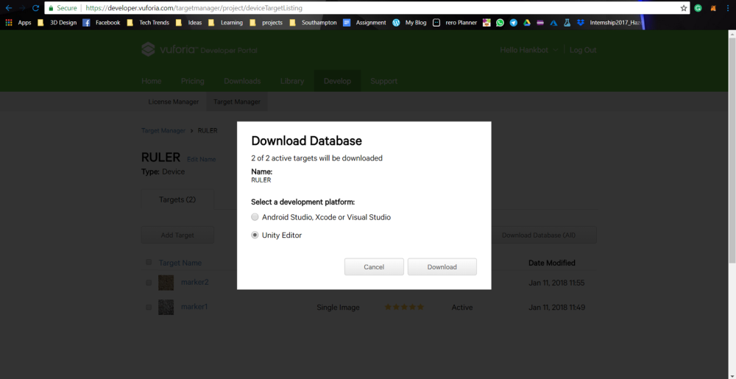
Vuforia Account Setup and Testing
5
Upload the images with the specifications below, you should have stone.jpg and wood.jpg in your zip folder.
6
Download the database, it should download as an <databasename>.unitypackage. (There is a sample for you to use in the zip file if you are unsure if yours is working.)

Slide 6
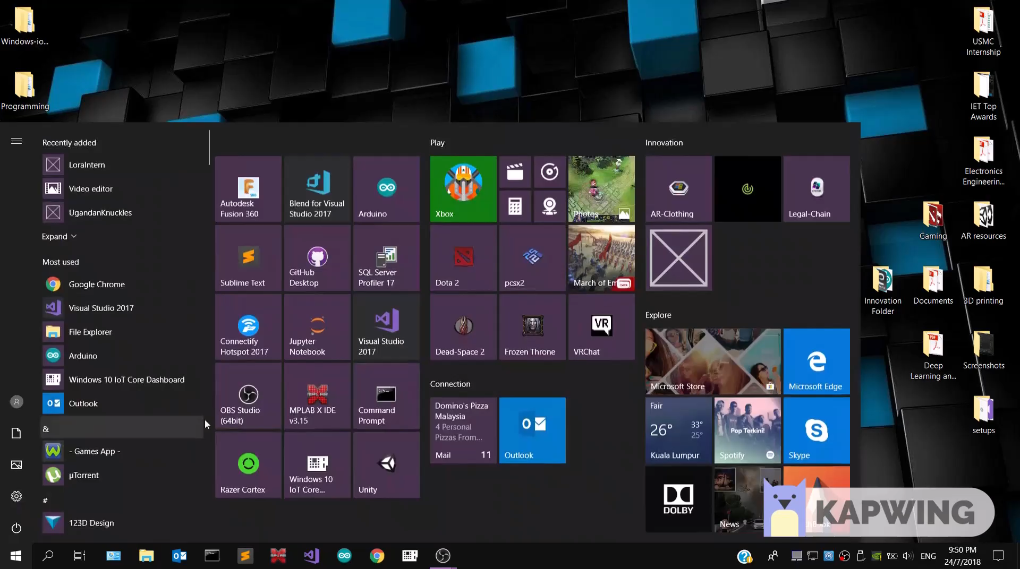
Vuforia Account Setup and Testing
Finally, follow the tutorial video below! You need a webcam or built-in camera for this. Only proceed to Android / XCode section if this part works! https://youtu.be/Oav5VILLNGU
7

Slide 7
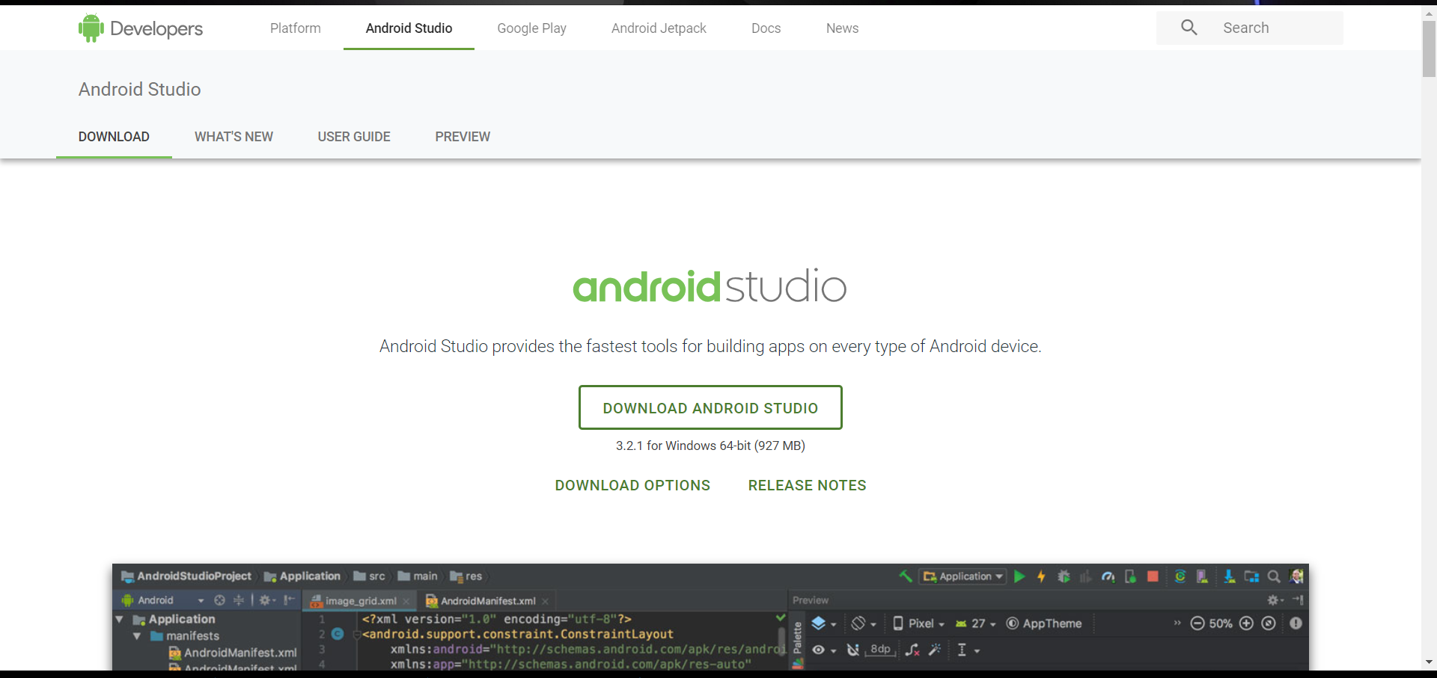
Getting Started (Android)
1
Once you have tested your Unity + Vuforia Software, let’s download android studio as well. https://developer.android.com/studio/
Note that android studio is supported on Mac as well, so if you have a Mac but is an Android User, please download Android User.

